Slide 1

Revitalizing Onga’s Distribution Network in the Southern Region
ADEROJU ADEYEMI
August 2024

Slide 2

OUTLINE
02
Potential Distributors Assessment
04
Distribution Strategy
06
Strategy Direction
Seasoning Market Analysis
Optimizing Onga’s Distribution
Network
30-60 Day Plan
01
03
05

Slide 3


STRATEGY
DIRECTION
The need to revamp Onga’s distribution network in the Southern region and enhance its reliability and coverage will involve the following strategic approach:
01
02
03
Market and Distribution Assessment
Redefine Distribution Partnerships
Logistics and Supply Chain Management
04
05
06
Invest in Technology and Infrastructure
Strengthen Relationships with Retailers and Consumers
Monitor, Evaluate, and Adapt

Slide 4









Market and Distribution Assessment
Evaluate current distributor performance to pinpoint specific issues causing stock outs and delays
Gather insights from retailers and consumers about their experience with Onga’s availability and service quality
Evaluate their ability to handle Onga’s volume and delivery requirements.
Check their existing network and relationships in the Southern region
Review their track record with similar products and distribution efficiency

Slide 5
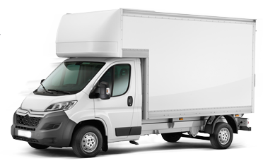




Strategy Direction
Direction
Redefine Distribution Partnerships
Choose distributors with proven performance and strong regional connections
Consider working with multiple distributors to cover different parts of the Southern region and reduce risk.
Define Key Performance Indicators (KPIs) such as delivery times, stock levels, and service quality
Implement SLAs with clear expectations for availability and performance.
Logistics and Supply Chain Management
Implement systems for real-time inventory tracking and demand forecasting
Maintain safety stock levels to mitigate the impact of supply chain disruptions..
Use data analytics to optimize delivery routes and reduce transit times
Establish local warehouses or distribution centers to improve responsiveness.
Invest in Technology and Infrastructure
Implement Enterprise Resource Planning (ERP) systems for better coordination between Onga and its distributors
Use mobile applications for real-time updates and communication with distributors.
Invest in upgrading or establishing warehouse facilities in strategic locations.
Enhance or expand the transport fleet to ensure reliable deliveries
Relationships with Retailers and Consumer
Offer training for retailers on handling and promoting Onga’s products
Provide incentives or promotional support to retailers who achieve sales targets or demonstrate high service levels
Launch targeted marketing campaigns in the Southern region to boost brand visibility and consumer loyalty
Create channels for consumer feedback to quickly address any issues related to product availability or quality
Monitor, Evaluate, and Adapt
Schedule regular meetings with distributors to review performance and address any issues
Continuously analyze sales data, distribution performance, and market trends to identify areas for improvement
Be prepared to adjust the distribution strategy based on performance data and market changes
Implement a process for continuous improvement based on feedback and performance metrics

Slide 6

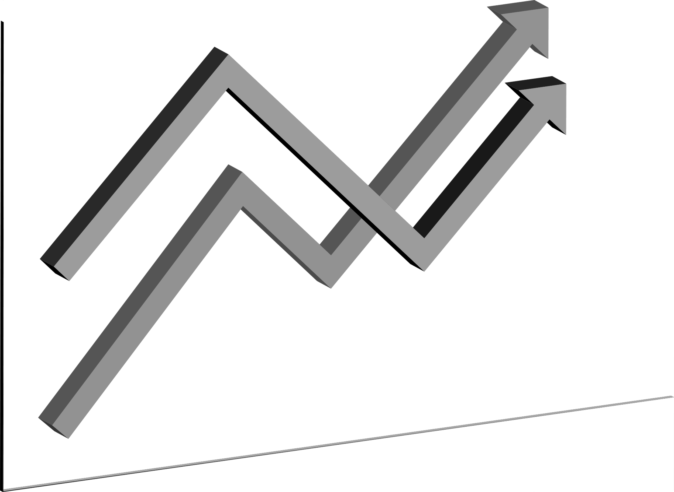
Seasoning Market Analysis
80%
20%

Slide 7


Market Overview
The Southern region of Nigeria represents a significant and dynamic market for seasoning products. This region's culinary preferences and consumer behaviors are crucial for brands like Onga, Knorr, and Maggi. The Southern market has been characterized by a competitive landscape with diverse consumer needs and high demand for reliable product availability

Slide 8





Current Market Trends
8
Health-Conscious Choices
Increase in Modern Retail Channels
With consumers becoming more aware of the ingredients in their seasoning products, brands that highlight natural ingredients or health benefits may have a competitive edge
The rise of modern retail channels, such as supermarkets and hypermarkets, is changing the distribution dynamics. Consumers are increasingly shopping at these outlets for convenience and a wider variety of products.
Shift Towards Consistency and Availability
Preference for Local Flavors
Digital Engagement and E-commerce
Frequent stockouts and inconsistent service from distributors have led to dissatisfaction, with consumers more likely to switch to brands that meet these expectations
Southern cuisine is diverse and often features unique local flavors. Seasoning brands that can cater to regional taste preferences and provide products that align with local culinary traditions are likely to perform better
There is a growing trend towards online shopping and digital engagement. Brands with strong online presence and e-commerce capabilities are better positioned to capture the attention of tech-savvy consumers.

Slide 9


Competitor Activities
9
With a well-established presence in the Southern region, supported by robust distribution networks and extensive marketing campaigns, the brand emphasizes its product's quality and taste, often positioning itself as a reliable choice for consumers
Knorr
Local and regional brands also compete in this market, offering products that cater to specific regional tastes. These brands often leverage their understanding of local preferences to differentiate themselves
Maggi
A dominant player in the seasoning market, with strong brand recognition and extensive distribution coverage. Its marketing strategies often focus on the versatility and convenience of its products, appealing to a broad consumer base
Local and Regional Brands

Slide 10

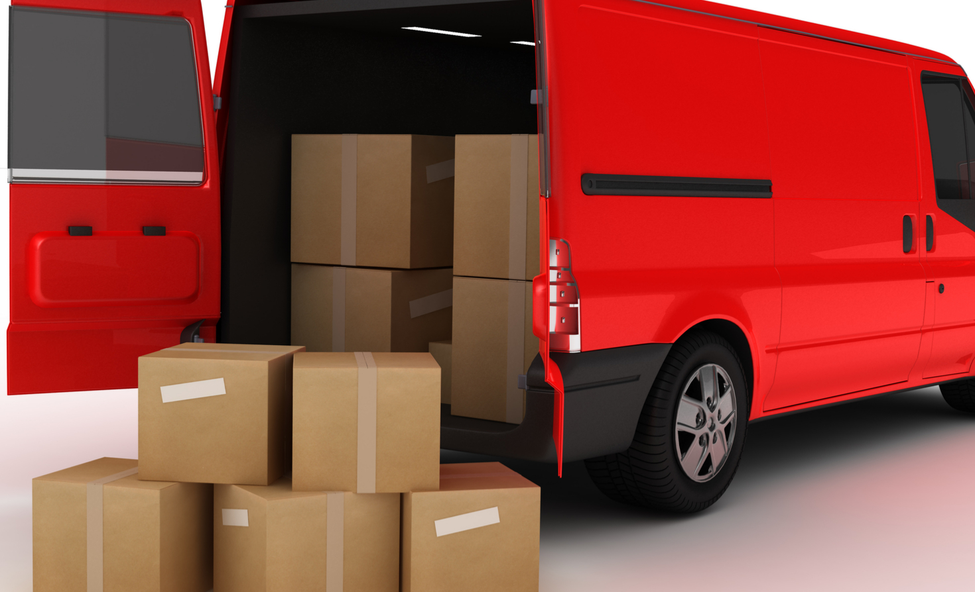

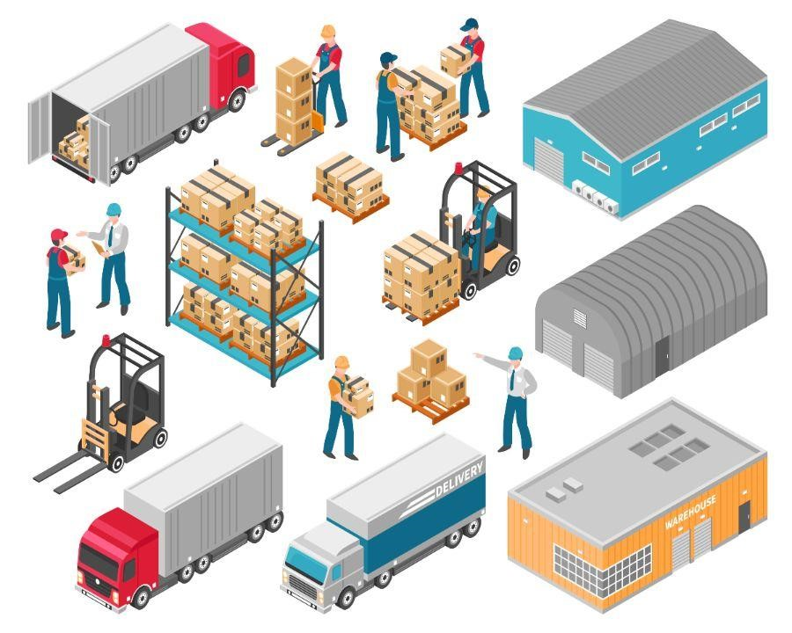
Distribution and Logistics Challenges
Inconsistent Supply Chains
The Southern region has faced challenges with inconsistent supply chains, leading to stockouts and delays. This has been a significant issue affecting consumer loyalty and brand performance
Market Penetration
Achieving effective market penetration requires strong relationships with local retailers and a deep understanding of regional distribution dynamics. Brands need to address these aspects to enhance their presence in the market
Logistical Constraints
Issues such as inadequate transportation infrastructure, complex distribution networks, and unreliable local distributors have contributed to the distribution problems experienced by brands in this region

Slide 11



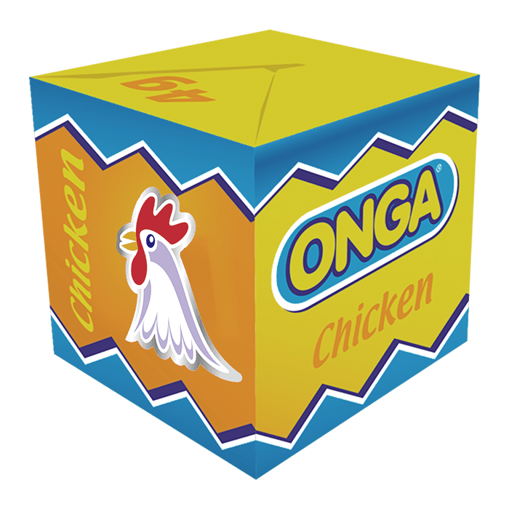


Strategic Recommendations
Distribution Reliability
Partner with well-established distributors who have proven logistical capabilities and a strong local presence
Leverage Local Insights
Modern Retail Channels
Utilize market research to understand local preferences and tailor product offerings and marketing strategies to meet regional demands
Increase presence in modern retail channels and explore e-commerce opportunities to align with changing consumer shopping habits
Brand Differentiation
Strengthen Relationships
Emphasize unique selling points, such as natural ingredients or specific health benefits, to appeal to health-conscious consumers
Build and maintain strong relationships with key retailers and distributors to ensure consistent product availability and support

Slide 12
POTENTIAL DISTRIBUTOR
ASSESSMENT
To assess potential new distributors in the Southern region for Onga, it's crucial to evaluate them based on specific criteria that align with addressing the current distribution challenges. Here’s a structured approach to this assessment:
01
02
03
Define Evaluation Criteria
Assessment Process
Ongoing Monitoring and Evaluation

Slide 13
EVALUATION CRITERIA
ASSESSMENT PROCESS
Logical Capabilities
Quality and capacity of warehouse facilities
fleet of vehicles reliability, and maintenance standards’
Availability of modern inventory management systems
Order processing systems efficiency
Ability to plan and execute optimized delivery
Historical performance in meeting delivery deadlines.
Phase
Key Initiatives
Request detailed proposals from potential distributors
Obtain references from current and past clients to validate their claims and assess reliability
Conduct site visits to inspect their warehouse facilities, transportation fleet, and operational processes
Observe their day-to-day operations to gauge their efficiency and effectiveness
Initial
Screening
Market Relationships
Existing network of retailers and their market penetration
Strength and quality of their relationships with key retailers and their ability to influence shelf space and visibility
Understanding of local market trends and consumer preferences
Awareness of competitor strategies and their ability to adapt to competitive pressures
Develop a scoring system to rate distributors on key criteria such as logistical capabilities, market relationships, experience, and financial stability.
Assign weights to each criterion based on its importance in addressing Onga’s distribution challenges
Use the evaluation matrix to rank potential distributors based on their overall scores
Identify top candidates who best meet the criteria and address existing distribution challenges
Develop
Evaluation Matrix
Experience and Track Record
Experience in handling similar seasoning or FMCG products.
Track record for handling and distributing products reliably and meeting performance standards
Ability to provide support to retailers and address any issues promptly
Track record in managing and resolving distribution-related issues effectively
Implement a trial period with selected distributors to test their performance and reliability in a real-world scenario
Monitor their performance closely during the trial period to ensure they meet Onga’s standards
Negotiate terms and conditions that align with Onga’s requirements, including performance expectations, SLAs, and pricing
Formalize the partnership with clear agreements on responsibilities, performance metrics, and support mechanisms
Final
Selection
Financial Stability
Financial stability and ability to invest in necessary infrastructure
Resources to invest in upgrading their facilities or expanding their operations if needed

Slide 14

Ongoing Monitoring and Evaluation
Set up regular performance reviews to ensure distributors continue to meet agreed-upon standards
Establish a feedback mechanism for continuous improvement and addressing any emerging issues
Regular Reviews
Be prepared to make adjustments to the distribution strategy based on performance data and market changes.
Adaptation
By following this structured assessment process, Onga can identify and partner with distributors who are well-equipped to address current challenges and support the brand’s growth in the Southern region

Slide 15

Revitalizing Onga’s Distribution Network in the Southern Region
…Strategic Plan to Address Distribution Challenges and Improve Market Penetration
ADEROJU ADEYEMI
August 2023

Slide 16
Executive Summary
Objective
Overhaul Onga’s distribution network in the Southern region to address stockouts, delays, and improve market share
Enhance distribution reliability and coverage.
Improve customer satisfaction and product availability.
Increase market share and competitive positioning
Key Goals

Slide 17
Current Distribution Challenges
Inconsistent Supply Chains
The Southern region has faced challenges with inconsistent supply chains, leading to stockouts and delays. This has been a significant issue affecting consumer loyalty and brand performance
Market Penetration
Achieving effective market penetration requires strong relationships with local retailers and a deep understanding of regional distribution dynamics. Brands need to address these aspects to enhance their presence in the market
Logistical Constraints
Issues such as inadequate transportation infrastructure, complex distribution networks, and unreliable local distributors have contributed to the distribution problems experienced by brands in this region

Slide 18

Market Overview and Competitor Analysis
18
Southern Region Market Trends
Growing demand for consistent product availability.
Increasing preference for health-conscious products.
Shift towards modern retail and e-commerce channels
With a well-established presence in the Southern region, supported by robust distribution networks and extensive marketing campaigns, the brand emphasizes its product's quality and taste, often positioning itself as a reliable choice for consumers
Knorr
A dominant player in the seasoning market, with strong brand recognition and extensive distribution coverage. Its marketing strategies often focus on the versatility and convenience of its products, appealing to a broad consumer base
Local and Regional Brands
Maggi
Local and regional brands also compete in this market, offering products that cater to specific regional tastes. These brands often leverage their understanding of local preferences to differentiate themselves

Slide 19
Evaluation of Potential New Distributors
EVALUATION CRITERIA
ASSESSMENT PROCESS
Logical Capabilities
Quality and capacity of warehouse facilities
fleet of vehicles reliability, and maintenance standards’
Availability of modern inventory management systems
Order processing systems efficiency
Ability to plan and execute optimized delivery
Historical performance in meeting delivery deadlines.
Phase
Key Initiatives
Request detailed proposals from potential distributors
Obtain references from current and past clients to validate their claims and assess reliability
Conduct site visits to inspect their warehouse facilities, transportation fleet, and operational processes
Observe their day-to-day operations to gauge their efficiency and effectiveness
Initial
Screening
Market Relationships
Existing network of retailers and their market penetration
Strength and quality of their relationships with key retailers and their ability to influence shelf space and visibility
Understanding of local market trends and consumer preferences
Awareness of competitor strategies and their ability to adapt to competitive pressures
Develop a scoring system to rate distributors on key criteria such as logistical capabilities, market relationships, experience, and financial stability.
Assign weights to each criterion based on its importance in addressing Onga’s distribution challenges
Use the evaluation matrix to rank potential distributors based on their overall scores
Identify top candidates who best meet the criteria and address existing distribution challenges
Develop
Evaluation Matrix
Experience and Track Record
Experience in handling similar seasoning or FMCG products.
Track record for handling and distributing products reliably and meeting performance standards
Ability to provide support to retailers and address any issues promptly
Track record in managing and resolving distribution-related issues effectively
Implement a trial period with selected distributors to test their performance and reliability
Monitor their performance closely during the trial period to ensure they meet Onga’s standards
Negotiate terms and conditions that align with Onga’s requirements, including performance expectations, SLAs, and pricing
Formalize the partnership with clear agreements on responsibilities, performance metrics, and support mechanisms
Final
Selection
Financial Stability
Financial stability and ability to invest in necessary infrastructure
Resources to invest in upgrading their facilities or expanding their operations if needed

Slide 20




Enhancing Distribution Reliability
Infrastructure Improvement
Upgrade or establish local warehousing.
Expand and modernize the transport fleet
Technology Integration
Implement real-time inventory tracking
Use ERP systems for better coordination
Route Optimization
Optimize delivery routes using data analytics
Maintain safety stock to handle disruptions

Slide 21


Strengthening Retailer and Consumer Relationships
Offer training for retailers on handling and promoting Onga’s products
Provide incentives or promotional support to retailers who achieve sales targets or demonstrate high service levels
Create channels for consumer feedback to quickly address any issues related to product availability or quality
Launch targeted marketing campaigns

Slide 22

Monitoring and Evaluation
22
Continuous Improvement
Adapt strategy based on feedback and performance data.
Implement a process for ongoing assessment and adjustment.
Performance Reviews
Regular performance evaluations of distributors.
Use KPIs and SLAs to measure success.

Slide 23
Financial and Resource Considerations
23
36%
Investment Requirements
Resource Allocation
26%
Costs associated with infrastructure upgrades, technology, and pilot testing.
Budget allocation and financial projections
Team and responsibilities for implementation
Timeline and milestones for the strategy rollout
24$
12%
10%

Slide 24

Conclusion
Key Points
Need for improved distribution network and reliability.
Strategic approach to selecting and partnering with new distributors.
Expected outcomes: Enhanced market presence, improved customer satisfaction, and increased market share
Next Steps
Approval of the proposed strategy
Initiation of the distributor selection and pilot testing phases

Slide 25

THANK YOU !

Slide 26
NEW DISTRIBUTION
STRATEGY

Slide 27
Implementation of New Distribution Strategy (1/2)
6
Pilot Testing
: Initiate a pilot phase with the selected distributors in a controlled environment
Monitor the pilot runs to assess performance against KPIs and identify any issues or areas for improvement
5
Upgrade Infrastructure and Technology
Coordinate the necessary upgrades to warehousing facilities and transport fleets
: Implement technology solutions such as ERP systems and inventory management
4
Distributor Selection and Onboarding
Finalize contracts with selected distributors, ensuring clear terms related to performance expectations, SLAs, and responsibilities
Develop an onboarding process to integrate new distributors into the Onga’s distribution network
3
Assemble a Cross-Functional Team
Identify team members with relevant expertise and assign roles such as project manager, logistics coordinator, market analyst etc.
Establish a governance structure with regular meetings and reporting mechanisms
2
Formulate a Project Plan
: Create a detailed project plan outlining the key phases of the implementation
Set specific timelines and milestones for each phase
1
Define Clear Objective and Goals
Clearly articulate the goals of the new distribution strategy
Establish Key Performance Indicators (KPIs) to measure the success of the new strategy

Slide 28
Implementation of New Distribution Strategy (2/2)
12
Risk Management
Assess potential risks associated with the implementation, such as resistance from current distributors etc
Develop risk mitigation plans and contingency strategies to address any challenges that may arise during the implementation process
11
Stakeholder Engagement
: Strengthen relationships with retailers by providing support and incentives
Engage with consumers through marketing campaigns and feedback channels
10
Report and Review
Conduct review meetings with the key stakeholders to discuss results, share successes, and plan for further improvements
Regularly generate performance reports to track progress against KPIs and evaluate the impact of the new distribution strategy
9
Communicate and Train
Keep the internal team informed about progress, changes, and successes
Provide ongoing training and support to distributors to ensure they adhere to Onga’s standards and best practices
8
Monitor Performance and Adjust
Make necessary adjustments to the strategy based on performance data & feedback
Continuously monitor
distributor performance
inventory levels
customer feedback
Establish a feedback loop with distributors and retailers issues promptly
7
Rollout and Full Implementation
Implement the new distribution strategy gradually, starting with a phased approach to manage risks and ensure smooth integration
Once the pilot phase is successful, proceed with full-scale implementation across the region

Slide 29
60-90
DAY PLAN

Slide 30

Phase 1: Research and Planning (Days 1-10)
Conduct a detailed market analysis for alcoholic and non-alcoholic beverages, beer, wine, spirits, and confectioneries
Identify key trends, popular brands, and consumer preferences
Evaluate competitors and their strategies for onboarding brands and building pipelines
Market Analysis
Craft a compelling value proposition for both brands and Brand Sales Partners.
Highlight unique selling points, such as market reach, sales support, and promotional strategies
Develop Value Proposition
Create a list of potential brands that align with the platform’s goals
Segment the list into high-priority and secondary brands based on their market presence and fit
Define Target Brands
Develop onboarding materials including presentations, pitch decks, and informational brochures
Prepare templates for agreements and contracts
Create Onboarding Materials

Slide 31
Phase 2: Outreach and Initial Engagement (Days 11-20)
Begin outreach to the top-tier target brands through emails, calls, and networking events
Schedule meetings or calls to present the platform’s value proposition
Reach Out to Target Brands
Connect with industry influencers or consultants who can provide introductions or endorsements
Leverage their networks to gain credibility and access
Engage Industry Influencers
Foster relationships with key decision-makers within the brands
Offer customized solutions and address specific needs or concerns
Build Brand Relationships

Slide 32
Phase 3: Recruitment of Brand Sales Partners (Days 21-30)
Define Partner Roles and Responsibilities
Outline the roles, responsibilities, and performance expectations for Brand Sales Partners
Develop a training and support plan to ensure their effectiveness
Screen applicants for experience and fit
Conduct interviews to assess their skills, knowledge, and potential for success
Screen and Interview Candidates
Launch a recruitment campaign to attract qualified Brand Sales Partners
Use job boards, industry networks, and social media to promote opportunities
Recruitment Campaign
Finalize hiring and begin the onboarding process.
Provide training on the platform, product categories, and sales techniques
Onboard Brand Sales Partners

Slide 33
Phase 4: Active Onboarding and Relationship Management (Days 31-60)
Initiate marketing campaigns to promote newly onboarded brands
Use social media, email marketing, and platform promotions to generate buzz and drive sales
Initial Marketing Campaigns
Continue working with brands that have shown interest or commitment
Facilitate the onboarding process, including contract signing and integration with the platform
Onboard Brands
Track the performance of onboarding efforts and sales activities
Gather feedback from brands and sales partners to make necessary adjustments
Monitor and Adjust Strategy
Provide ongoing support and resources to Brand Sales Partners
Monitor progress and provide feedback to ensure alignment with goals
Assess the onboarding of at least four viable brands and ensure at least two Brand Sales Partners are effectively integrated
Prepare a report on achievements, challenges, and next steps
Support Brand Sales Partners
Evaluate Progress

Slide 34

Key Metrics for Success
Brand Onboarding
Minimum of 4 viable brands successfully onboarded
Pipeline Growth
Increased number of leads and potential brand partnerships
Sales Partners
At least 2 Brand Sales Partners onboarded and actively reporting
Engagement
Positive feedback from brands and partners on the onboarding process and support.

